Slide 1
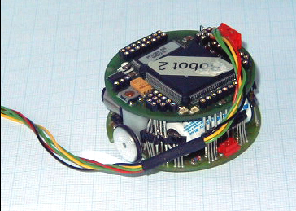
The Khepera Robot
Khepera is a miniature robot that is used for research and education at more than 350 institutes around the world.
It is very small, about 55mm in diameter, and has two motors and 8 infrared proximity/light sensors.
Also there are some extansion modules available for the Khepera, eg: gripper, camera.

Slide 2
How to control
The Khepera robot can be controlled from a computer by a serial port.
There are command packages that controls the Khepera.
Sending the command 'D,10,15' tells the Khepera to set the left motor speed to 10/pulses/10ms and the right motor speed to 15 pulses/10ms. Also Khepera returns information to the computer from proximity sensor readings.

Slide 3
KIKS
As a master thesis at Umeå University, Theodor Nilsson has created a Khepera simulator referred to as KIKS.
Kiks stands for “KiKS is a Khepera Simulator”.
It runs in Matlab 5.3 or above.
It simulates Khepera well enough to allow programs that have been written for physical robots to be transferred to simulator environment.

Slide 4
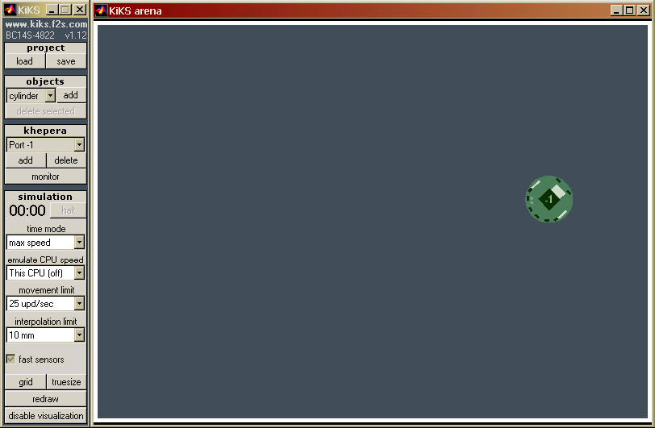
Simulator Overview

Slide 5
There are some other mostly used simulators for the Khepera.
  Olivier Michel: Khepera Simulator version 2.0 (freeware)
  Cyberbotics: Webots (commercial product)
  Oliver Michel and Pr. Heino Iwe: EasyBot (freeware)

